Slide 1
TESTING TOOLS
COMP220/285
© University of Liverpool
slide <number>

Slide 2
Objectives
At the end of this lecture, you should be able to
  Describe some common software tools
  Describe how different parts of a multi-tier application are tested
  Describe how databases can be tested/monitored
COMP220/185
© University of Liverpool
slide <number>

Slide 3
Web Page testing
API will send
  Requests to load up web pages
  Clicks of buttons (submit) and links
  Setting of test fields in web forms
API will parse response to determine
  Title of page
  Error status
  Validity of fields on page
COMP220/185
© University of Liverpool
slide <number>

Slide 4
JWebUnit
Provides web site testing API
Features
  Programmatic testing control
  Location, click, page parsing
  Javascript execution
Limitations
  Only some core javascript is executed and understood
  Slower than browser, Javascript, v.slow
COMP220/185
© University of Liverpool
slide <number>

Slide 5
JWebunit Example
HtmlUnitTestingEngineImpl webunit=new HtmlUnitTestingEngineImpl();
webunit.setScriptingEnabled(false);
try {
webunit.beginAt(new URL("http://seb.fruitserver.com/mobile/lobby/Default.aspx"),new TestContext());
} catch (Exception exc) {
exc.printStackTrace();
System.exit(1);
}
webunit.clickLinkWithExactText("Sign In",0);
System.out.println("Page title is "+webunit.getCurrentPageTitle());
webunit.setTextField("tbEmail", "testsc01");
webunit.setTextField("tbPIN", "1608");
webunit.submit();
System.out.println("Page title is "+webunit.getCurrentPageTitle());
COMP220/185
© University of Liverpool
slide <number>

Slide 6
Remote controlled browser testing
Loads up the browser
Requests browser to open page
Populates forms on page with data
Goes to next page
Example
  Selenium
    IDE plug for Firefox (record, playback, web actions)
    Remote control API (Firefox, Chrome, iOS)
COMP220/185
© University of Liverpool
slide <number>

Slide 7
Why remote control
Software doesn’t run in simulated but real environment
Javascript/css support is different in different browsers
Performance changes across browsers
Javascript interactions such as Ajax will work properly
COMP220/185
© University of Liverpool
slide <number>

Slide 8
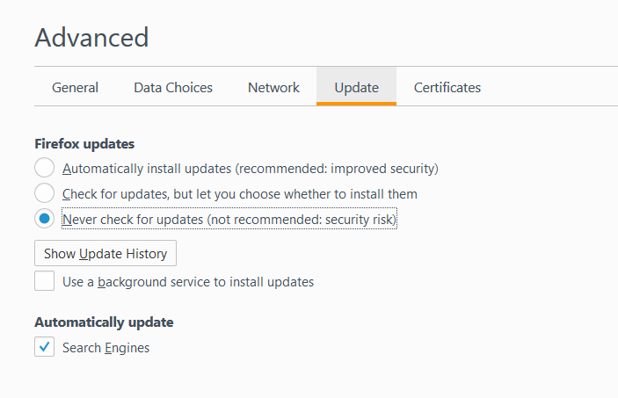
Selenium IDE (running with Firefox)
Doesn’t work with latest Firefox (v<=54)
So uninstall and get earlier version
https://ftp.mozilla.org/pub/firefox/releases/54.0/
Disable
Auto update
COMP220/185
© University of Liverpool
slide <number>

Slide 9
Firefox disabling updates
Remove the following service
  Mozilla maintenance service
In windows use
  Add Remove programs
  Remove Mozilla maintenance service
COMP220/185
© University of Liverpool
slide <number>

Slide 10
Installing Selenium IDE
https://addons.mozilla.org/en-US/firefox/addon/selenium-ide/
Click Add to Firefox
Give permission to install and then re-start Firefox
COMP220/185
© University of Liverpool
slide <number>

Slide 11
Selenium IDE with Chrome
A lot easier no version issue
https://chrome.google.com/webstore/detail/selenium-ide/mooikfkahbdckldjjndioackbalphokd
COMP220/185
© University of Liverpool
slide <number>

Slide 12
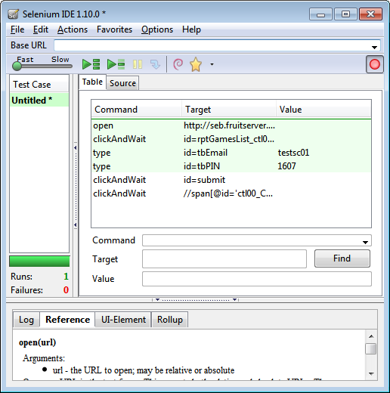
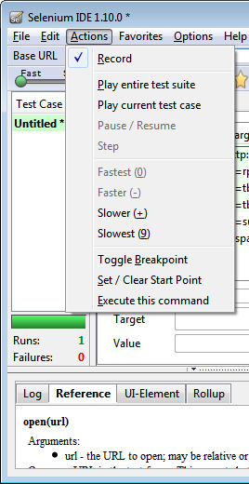
Selenium IDE
COMP220/185
© University of Liverpool
slide <number>

Slide 13
Selenium IDE commands
All commands have name, target, value
open
  Opens a page
  Arguments
    target = URL
    target=http://gmail.com
type
  Types text into text box
  target (identity of element)
    id=
    name=
  value
    Value to type in
COMP220/185
© University of Liverpool
slide <number>

Slide 14
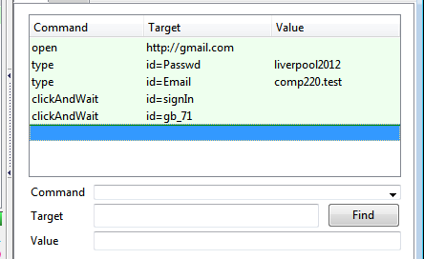
Example open gmail account
Username = comp220.test
Password = liverpool2012
COMP220/185
© University of Liverpool
slide <number>

Slide 15
clickAndWait
Clicks an element on the web page and then waits for it to load
Target defined as
  id
  name
COMP220/185
© University of Liverpool
slide <number>

Slide 16
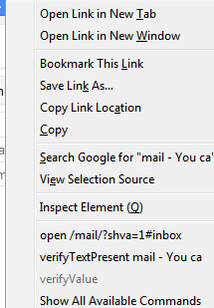
Assertions
Test if values are what is expected
Adding an assertion using Selenium IDE
  Right click on element
  Look for
    VerifyTextPresent
COMP220/185
© University of Liverpool
slide <number>

Slide 17
Test case format
<tr>
<td>open</td>
<td>http://gmail.com</td>
<td></td>
</tr>
<tr>
<td>type</td>
<td>id=Passwd</td>
<td>liverpool2012</td>
</tr>
<tr>
<td>type</td>
<td>id=Email</td>
<td>comp220.test</td>
</tr>
<tr>
<td>clickAndWait</td>
<td>id=signIn</td>
<td></td>
</tr>
COMP220/185
© University of Liverpool
slide <number>

Slide 18
Selenium web driver
Connects your program to browser to allow remote control
Example code…
driver = new ChromeDriver();
driver.get("http://gmail.com");
driver.findElement(By.id("Passwd")).clear(); driver.findElement(By.id("Passwd")).sendKeys("liverpool2012");
driver.findElement(By.id("Email")).clear();
driver.findElement(By.id("Email")).sendKeys("comp220.test");
driver.findElement(By.id("signIn")).click();
COMP220/185
© University of Liverpool
slide <number>

Slide 19
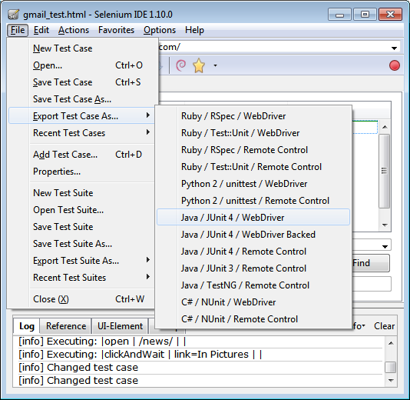
Exporting test cases to program
COMP220/185
© University of Liverpool
slide <number>

Slide 20
Test case exported
@Before
public void setUp() throws Exception {
System.setProperty("webdriver.chrome.driver", "C:\\comp285\\chromedriver.exe");
driver = new ChromeDriver();
baseUrl = "https://accounts.google.com/";
driver.manage().timeouts().implicitlyWait(30, TimeUnit.SECONDS);
}
@Test
public void testGmailTestWebdriver() throws Exception {
driver.get("http://gmail.com");
driver.findElement(By.id("Passwd")).clear();
driver.findElement(By.id("Passwd")).sendKeys("liverpool2012");
driver.findElement(By.id("Email")).clear();
driver.findElement(By.id("Email")).sendKeys("comp220.test");
driver.findElement(By.id("signIn")).click();
COMP220/185
© University of Liverpool
slide <number>

Slide 21
Test case exported
try {
assertTrue(driver.findElement(By.cssSelector("BODY")).getText().matches("^[\\s\\S]*comp220\\.test@gmail\\.com[\\s\\S]*$"));
} catch (Error e) {
verificationErrors.append(e.toString());
}
assertTrue(driver.findElement(By.cssSelector("BODY")).getText().matches("^[\\s\\S]*comp220\\.test@gmail\\.com[\\s\\S]*$"));
driver.findElement(By.id("gbgs4dn")).click();
driver.findElement(By.id("gb_71")).click();
}
COMP220/185
© University of Liverpool
slide <number>

Slide 22
Test case exported
@After
public void tearDown() throws Exception {
driver.quit();
String verificationErrorString = verificationErrors.toString();
if (!"".equals(verificationErrorString)) {
fail(verificationErrorString);
}
}
COMP220/185
© University of Liverpool
slide <number>

Slide 23
Performance testing
Typical architecture
Application
Server
php/,Net/Servlet
Ruby
Database
B
R
O
W
S
E
R
Internet
LAN
COMP220/185
© University of Liverpool
slide <number>

Slide 24
Performance testing
Assuming a 3-tier architecture, problems with performance could be
  In browser (e.g. javascript performance issue)
  In transmission network (e.g. size of download, images, jscript, HTML)
    Particularly true with mobile network
  Within LAN
  At Application server
  At Database server
COMP220/185
© University of Liverpool
slide <number>

Slide 25
Testing Performance problems
Browser side
  Function of content and browser
So test needs to be done
  On browser
  But automatically
Needs support for
  Remote control of browser
  See last topic
COMP220/185
© University of Liverpool
slide <number>

Slide 26
Internet speed simulation
Slow internet connections cause
  Connections to timeout
  Requests to fail
  User experience may suffer
Issues
  Software may send multiple requests
  Loading screens need testing
  Code can measure link speed, then optimize
  With mobile applications slow network speed is common
COMP220/185
© University of Liverpool
slide <number>

Slide 27
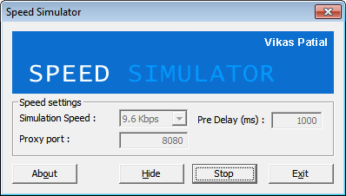
Internet Speed Simulation
http://www.ngcoders.com/downloads/internet-speed-simulator-proxy-throttler/
Browser connects to speed simulator via proxy interface
COMP220/185
© University of Liverpool
slide <number>

Slide 28
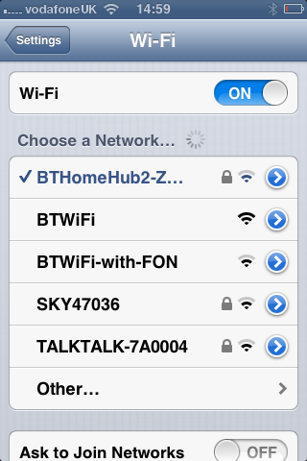
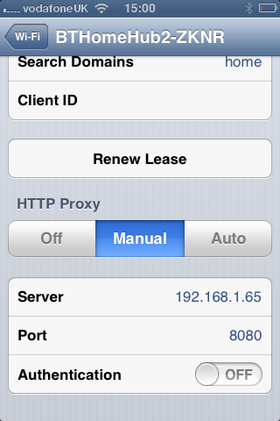
Configuring the proxy interface
Firefox
  Tools/Options/Advanced/Network/Settings
iPhone
  Settings/WiFi/Choose a Network
COMP220/185
© University of Liverpool
slide <number>

Slide 29
Android proxy configuration
Applications/Settings/Wi-Fi
Tap and hold Wi-Fi connection, then Modify Network
Check Show Advanced options
Enter proxy via manual settings
COMP220/185
© University of Liverpool
slide <number>

Slide 30
Server side performance testing
Application server
  Performance related to request load and service time
  In general traffic measured in Erlangs
  Erlang = service time/request interval
  So
    A load of 200 requests per second = request interval = 5 ms
    If each request takes on average 3 ms to service
    Load = 3/5 = 0.6 Erlangs
COMP220/185
© University of Liverpool
slide <number>

Slide 31
Application server/Database loading
If the transaction only involves the middle tier
  Performance generally only current load
Database transaction time depends on
  Database load
  State of database
    Size of tables
    Complexity of transaction (table joins etc.)
    Table locking or transactional operations
COMP220/185
© University of Liverpool
slide <number>

Slide 32
Example SQL
Balance query
  Select sum(amount) from account_transaction where userid=1234 and account=25
Login
  select * from users where login=“fred”
Joins (orphan transaction search)
  select TransactionID from user as a right outer join account_transaction as b on a.CustomerID = b.CustomerID where a.CustomerID is null;
COMP220/185
© University of Liverpool
slide <number>

Slide 33
Bench marking queries
Important to benchmark queries with given sizes of table
  Looking up user/password in
    10,000 users
    250,000 users
  Find transaction balance for table with
    100,000 or 250,000,000 transactions
At what point will service suffer
Need to insert alerts when tables grow to critical size
COMP220/185
© University of Liverpool
slide <number>

Slide 34
mysqlslap
Used to stress test your database
Can run this
  On it own to get benchmark
  Concurrently with application
Parameters
  --concurrency=500
  --iterations=20000
  --query
  --user, --password
COMP220/185
© University of Liverpool
slide <number>

Slide 35
Database load testing
Have test patterns which
  Do complex operations such as creating many new accounts
  Fill up tables with multiple transactions
  Do many different transactions at the same time
    Creating accounts
    Logging in
    Performing transactions
COMP220/185
© University of Liverpool
slide <number>

Slide 36
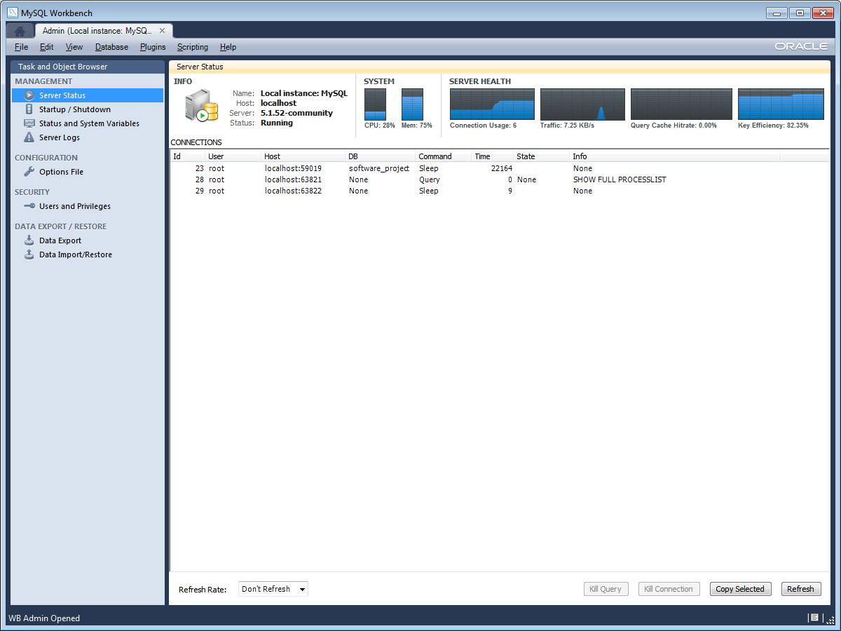
Database monitoring
COMP220/185
© University of Liverpool
slide <number>

Slide 37
Database monitoring and alerting
Monitoring
  Examine in real time state of database
  Heavy loading could be due to
    Normal increase in customer traffic
    DOS attack
    Problems with table scaling
Alerts
  Certain load conditions
  Slow queries
  Too many SQL errors
COMP220/185
© University of Liverpool
slide <number>

Slide 38
Query cache
Allows repeated queries to be returned without examining tables
If table(s) not altered and query repeated on table, then result can come from query cache
Use of the query cache will affect the performance of benchmarking tests
  Disable cache
  Make cache size v.small
COMP220/185
© University of Liverpool
slide <number>

Slide 39
MySQL slow query log
Can be configured to store queries which take over a certain time threshold
  e.g. >10 seconds
Slow queries will
  Cause that user to suffer poor service
  Push other queries back up the queue
  If combined with table locking, cause other queries to lock out
COMP220/185
© University of Liverpool
slide <number>

Slide 40
Summary
Testing involves
  Strategy of what to test
Need to test
  All parts of multi-tier application
  Under different conditions
  Database performance changes as it grows
Need for monitoring
  Keep testing/monitoring live site
COMP220/185
© University of Liverpool
slide <number>

